Slide 1
Staff Request to Recruit Form
Full Time Employees
Human Resources
College of Arts and Sciences

Slide 2
Tips for Starting your Request
It is important to have the information needed to complete the form prior to starting your request. The form cannot be saved as a draft.
This form should be used to hire or fill any vacant or new exempt/nonexempt position within the College of Arts and Sciences. Should you need to fill multiple positions that are new or a combination of new and existing positions with different titles, funding sources, etc. or if you are filling more than one waived search, you will need to submit multiple forms.
If you have any questions, please contact your HR representative or CAS-HR@udel.edu for assistance.

Slide 3
Guide Contents
Pages 03-16: Requesting an Open Search with an Existing Position Number.
Pages 17-30: Requesting an Open Search with a New Position Number.
Pages 31-47: Requesting a Waived Search with an Existing Position Number.
Pages 48-64: Requesting a Waived Search with a New Position Number.

Slide 4
Requesting an External Search with an Existing Position Number

Slide 5
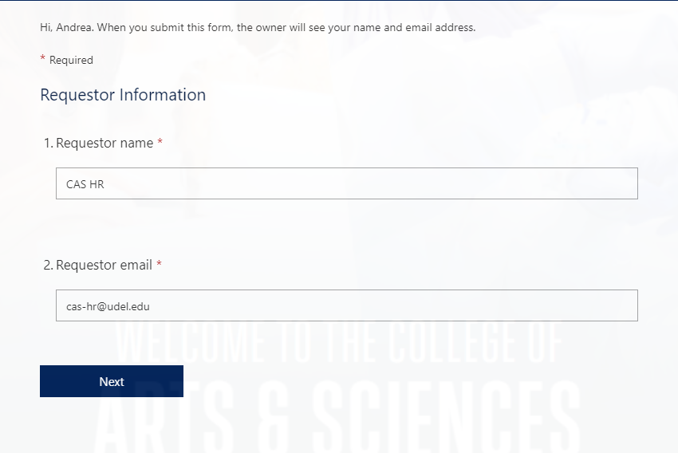
Requestor Information
Please enter the requestor’s name
Enter the email address.
If you are entering this information for another staff or faculty member, please enter their information.

Slide 6
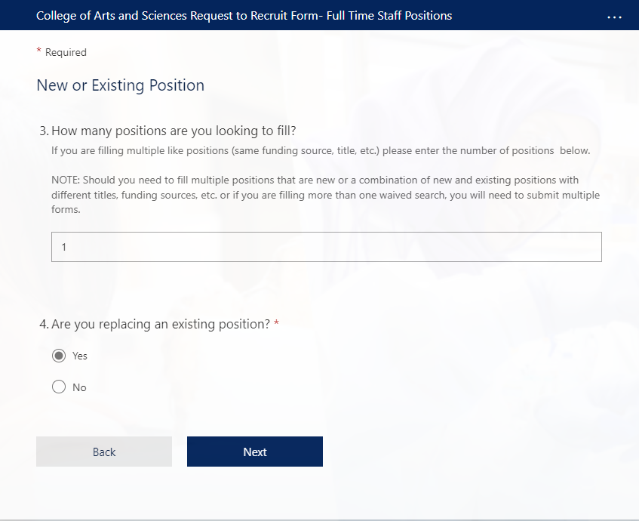
New or Existing Position
3. Enter the number of positions you are requesting to fill.
Please note that if you need to fill multiple positions that are a combination of new and existing positions with different titles, funding sources, etc. or if you are filling more than one waived search, you will need to submit multiple forms.
4. Select ‘Yes’ to replace an existing position.

Slide 7
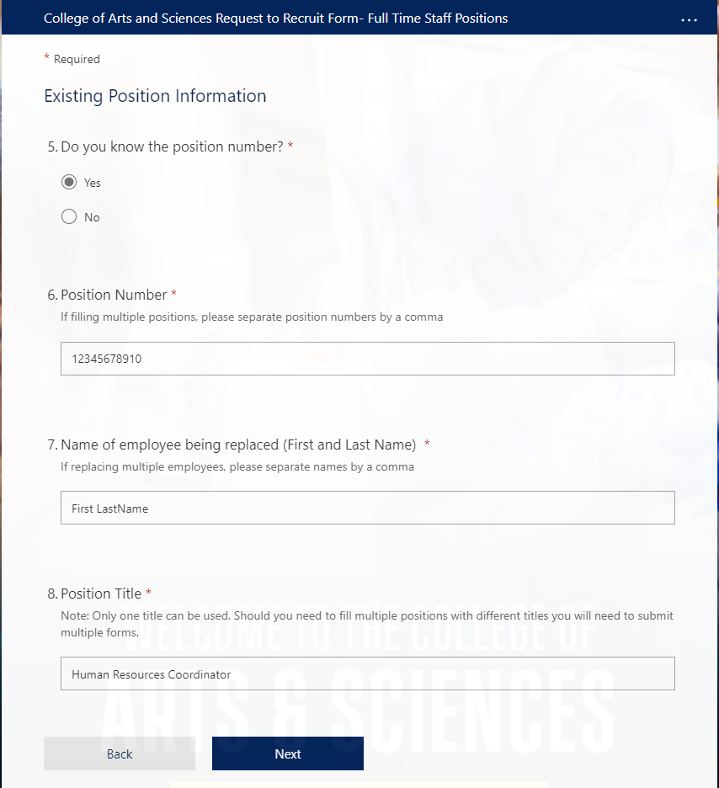
Existing Position Information 5. If you know the position number, please select Yes. If not, please select No. If you select No, you will you will be prompted to enter the name of the employee you will be replacing and their position title. These will present themselves as additional questions. 6. If you selected yes for the above question, will be required to enter the position number. If you are filling multiple positions, please separate numbers by a comma. 7. Enter the first and last name of the employee(s) being replaced. If you are replacing multiple employees, please separate names by a comma. 8. Enter the position title. If you need to fill multiple positions with different titles you will need to submit multiple forms.

Slide 8
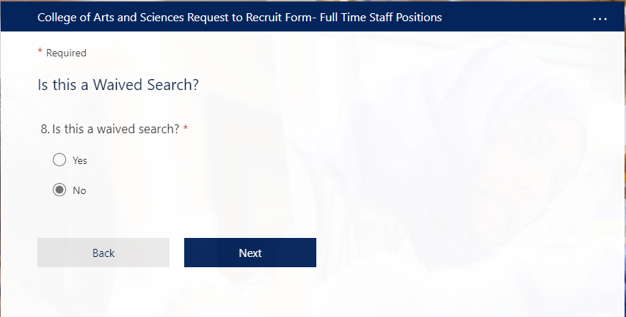
Is this a Waived Search? 8. Select No.

Slide 9
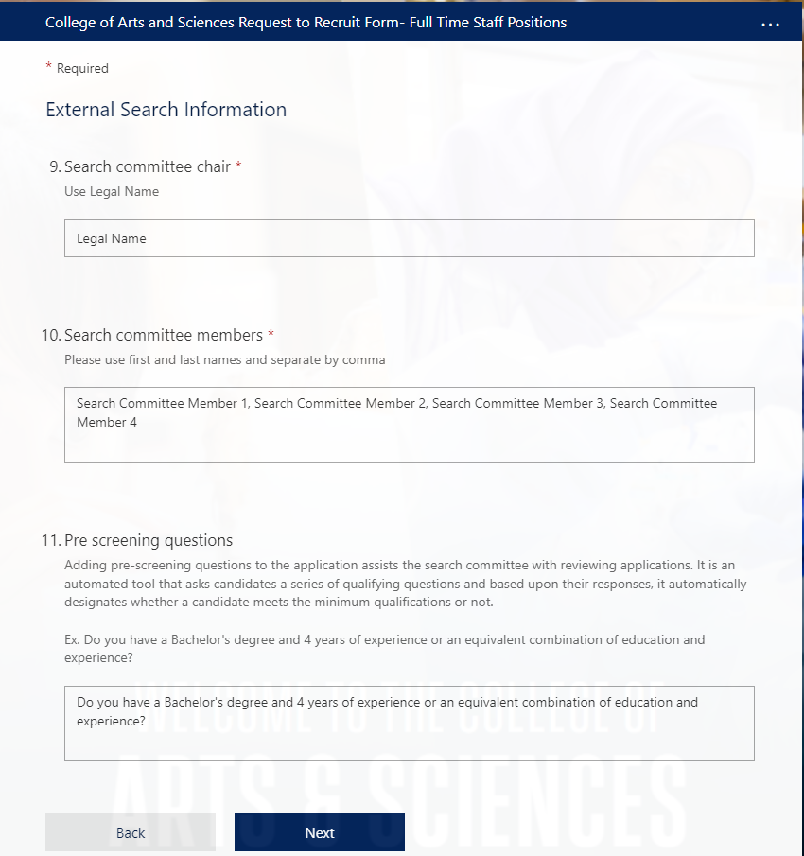
External Search Information 9. Enter the Search Committee Chair’s Legal Name. 10. Enter the Search Committee members using their legal name. Please separate by comma. 11. Enter pre-screening questions. Adding pre screening questions to the application assists the committee with reviewing applications. It is an automated tool that asks candidates a series of qualifying questions and based upon their responses, it automatically designates whether a candidate meets the minimum qualifications or not.

Slide 10
General Position Questions 12. Select the Portfolio/Unit that the position falls under.

Slide 11
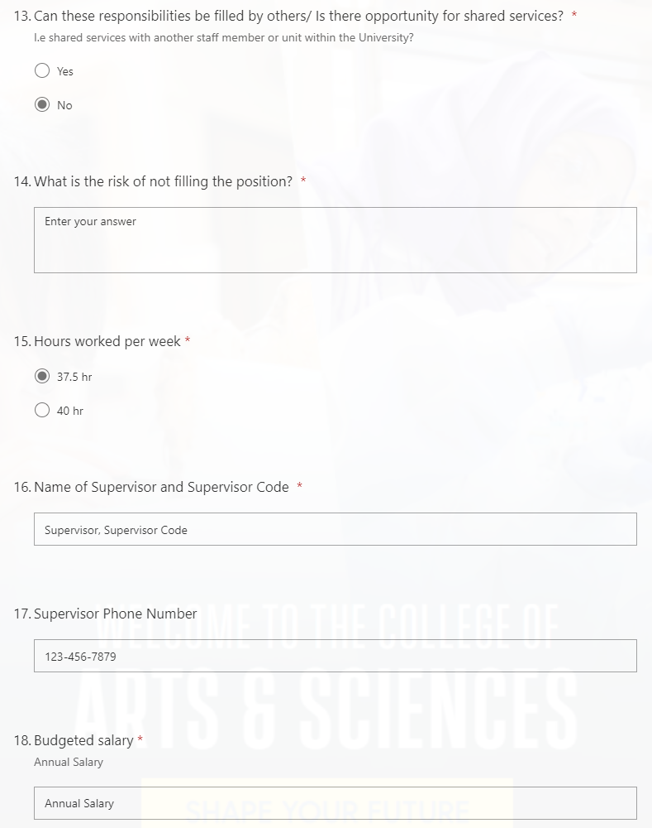
General Position Questions Continued 13. Select Yes or No If you select Yes, you will need to provide an explanation below. This option will reveal itself as an additional question. 14. Enter your answer for the risk of not filling the position. 15. Select the hours worked per week. 16. Enter the name of the Supervisor and Supervisor Code. 17. Enter the Supervisor Phone Number. 18. Enter the Budgeted Salary.

Slide 12
General Position Questions Continued 19. Select the Work Schedule. If you select Other, you will need to provide the work schedule. This option will reveal itself as an additional question. 20. Select Yes or No 21. Select 100% or Less than 100% If you select less than 100% , please provide the percentage of the job that can be performed remotely and the hybrid work schedule. Selecting these options will reveal additional questions below. 22. Enter the Purpose Code and Title. If you are using split funding please provide the purpose codes, titles and percentages.

Slide 13
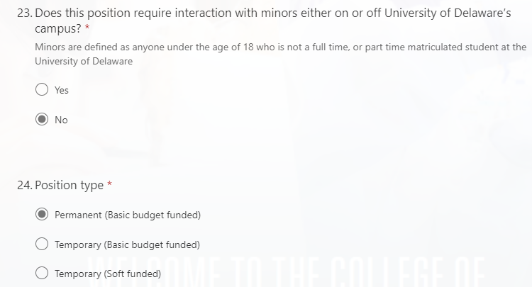
General Position Questions Continued 23. Select Yes or No 24. Select the Position Type If you select a temporary position, the years of funding duration options will be revealed as an additional question below.

Slide 14
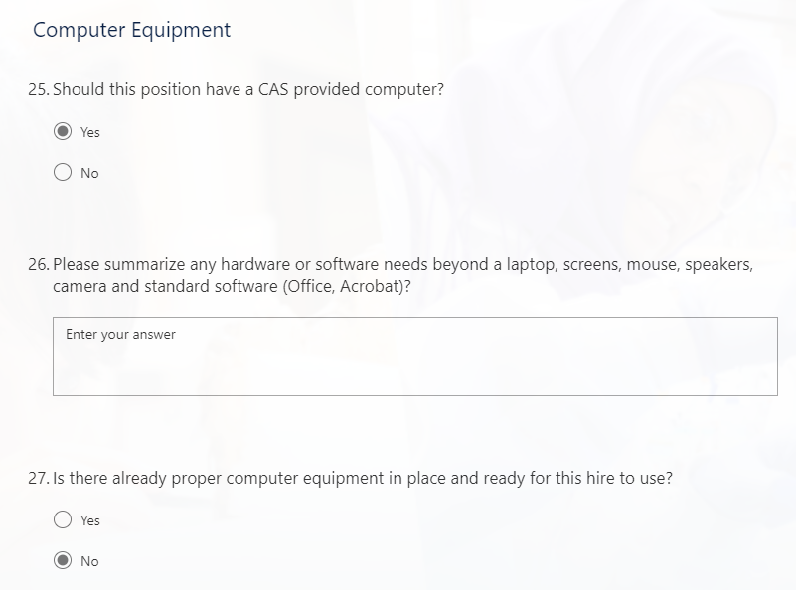
Computer Equipment 25. Select Yes or No. 26. Enter the hardware and software needs. 27. Select Yes or No If you select yes, please enter the name of the employee who was last assigned the computer. This will present itself as an additional question below.

Slide 15
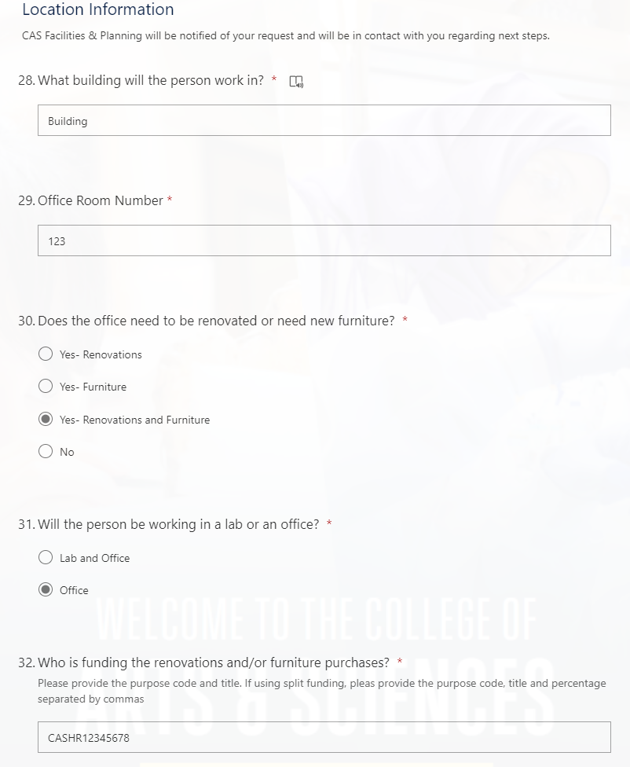
Location Information 28. Enter the building that the person will be working in. 29. Enter the office room number. 30. Select Yes or No. 31. Select Lab & Office OR Office If selecting Lab and Office, lab location and renovation questions will appear below. 32. Enter the purpose code. If using split funding, please provide the purpose code, title and percentage separated by commas

Slide 16
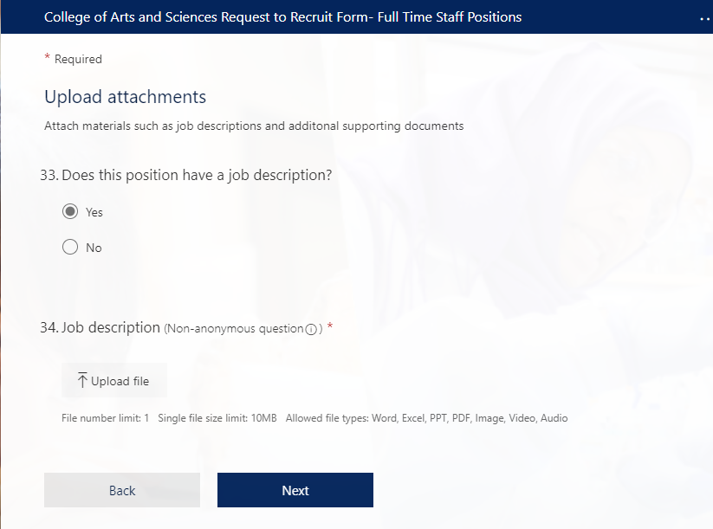
Upload Attachments 33. Select Yes or No. 34. If Yes, Upload the job description.

Slide 17
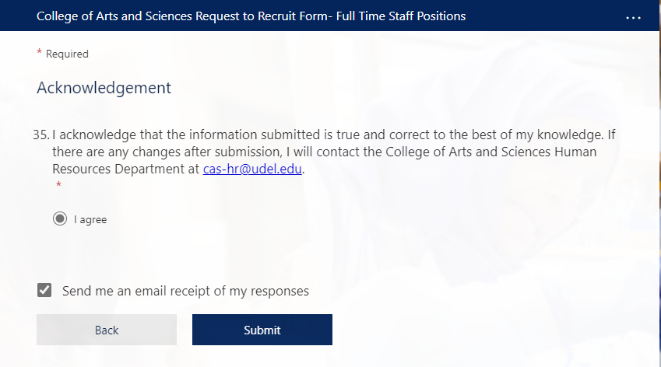
Acknowledgement 35. Select ‘I agree’. If you would like an emailed receipt of your responses, please select the check box. Click Submit.

Slide 18
Requesting an External Search with a New Position Number

Slide 19
Requestor Information
Please enter the requestor’s name
Enter the email address.
If you are entering this information for another staff or faculty member, please enter their information.

Slide 20
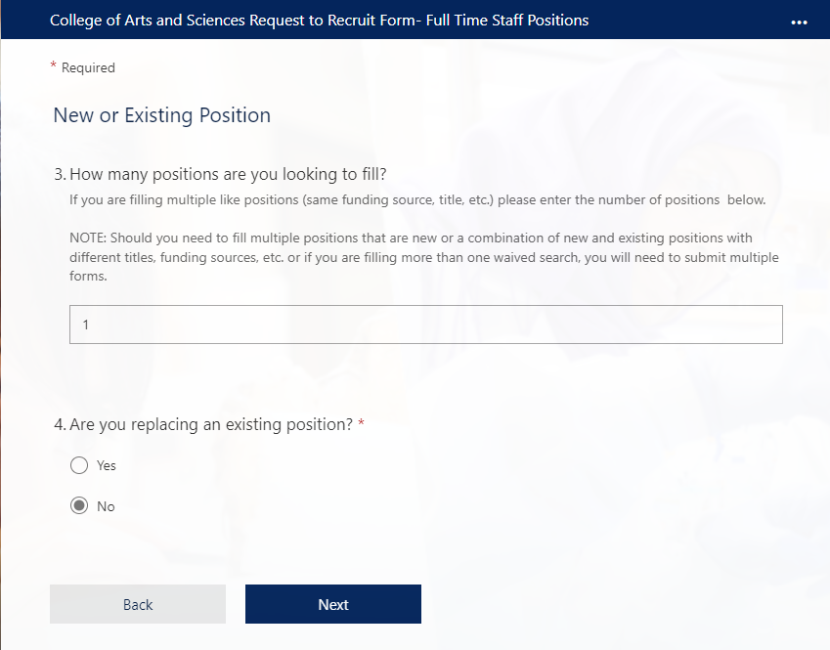
New or Existing Position
3. Enter the number of positions you are requesting to fill.
Please note that if you need to fill multiple positions that are a combination of new and existing positions with different titles, funding sources, etc. or if you are filling more than one waived search, you will need to submit multiple forms.
4. Select No to replace an existing position.

Slide 21
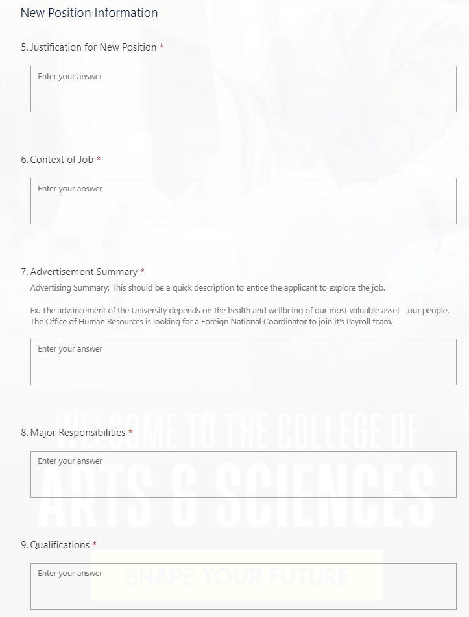
New Position Information
5. Enter the justification for the new position.
6. Provide context of the job.
7. Create an advertisement summary
This should be a quick description to entice the applicant to explore the job.
8. State Major Responsibilities.
9. Enter the Qualifications.

Slide 22
Is this a Waived Search?
10. Select No

Slide 23
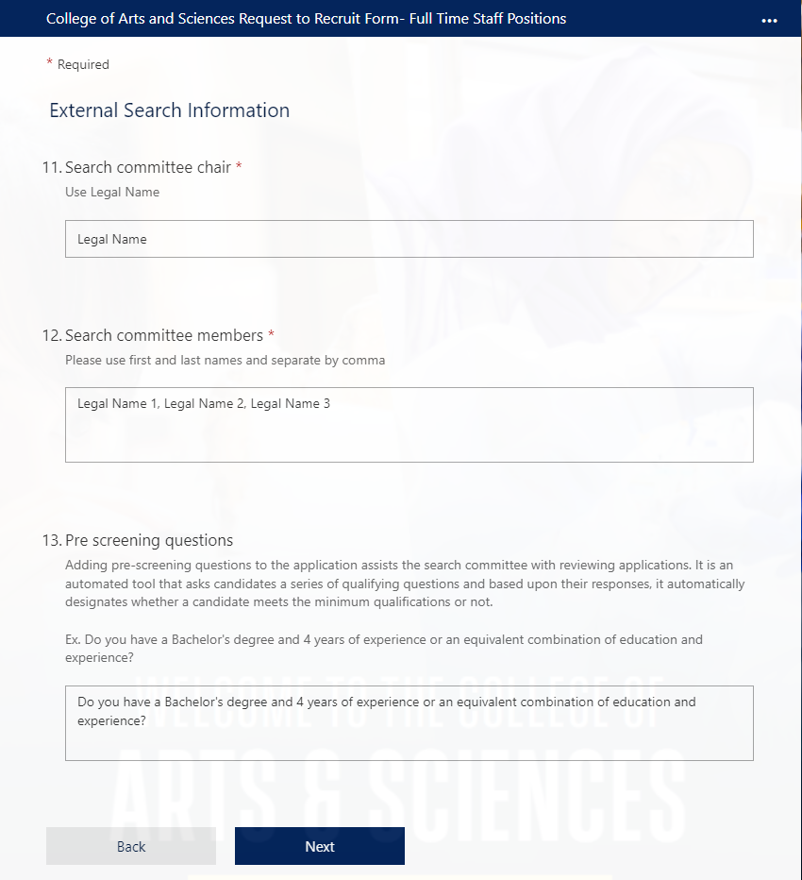
External Search Information
11. Enter the Search Committee Chair’s Legal Name 12. Enter the Search Committee members using their legal name. Please separate by comma 13. Enter pre-screening questions. Adding pre-screening questions to the application assists the committee with reviewing applications. It is an automated tool that asks candidates a series of qualifying questions and based upon their responses, it automatically designates whether a candidate meets the minimum qualifications or not.

Slide 24
General Position Questions
14. Select the Portfolio/Unit that the position falls under.

Slide 25
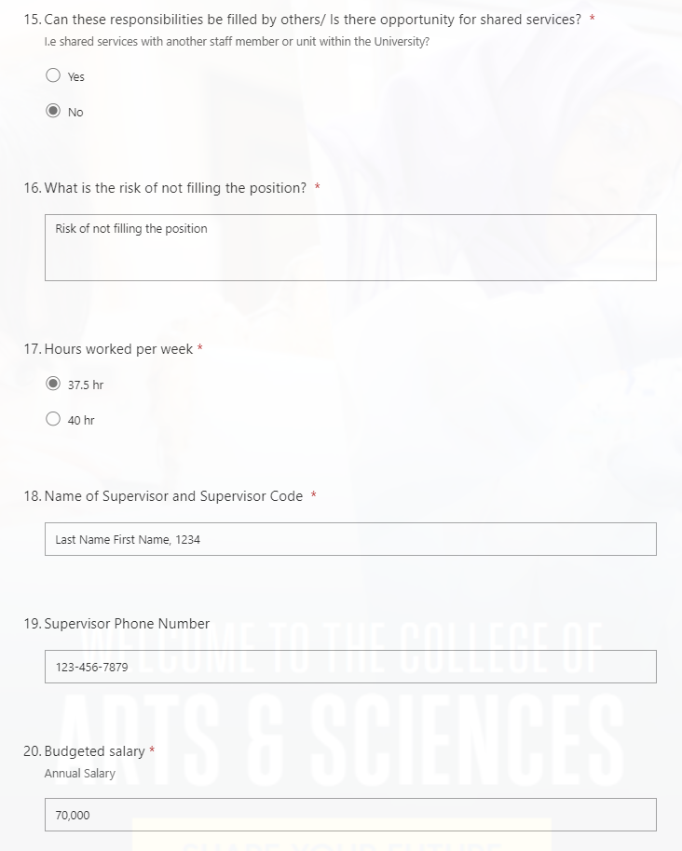
General Position Questions Continued
15. Select Yes or No
If you select Yes, you will need to provide an explanation below. This option will reveal itself as an additional question. 16. Enter your answer for the risk of not filling the position. 17. Select the hours worked per week. 18. Enter the name of the Supervisor and Supervisor Code . 19. Enter the Supervisor Phone Number. 20. Enter the Budgeted Salary.

Slide 26
General Position Questions Continued
21. Select the Work Schedule. If you select Other, you will need to provide the work schedule. This option will reveal itself as an additional question. 22. Select Yes or No. 23. Select 100% or Less than 100% If you select less than 100% , please provide the percentage of the job that can be performed remotely and the hybrid work schedule. Selecting these options will reveal additional questions below. 24. Enter the Purpose Code and Title. If you are using split funding please provide the purpose codes, titles and percentages.

Slide 27
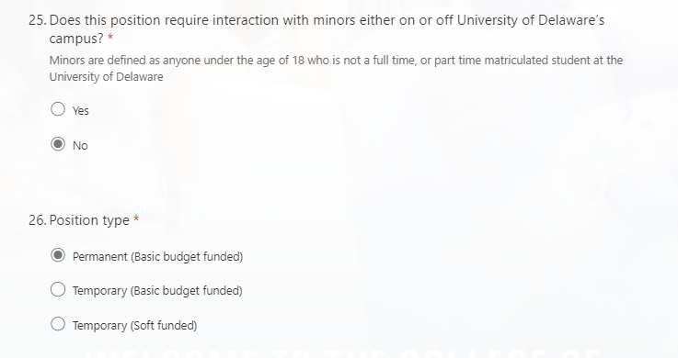
General Position Questions Continued
25. Select Yes or No .
26. Select the Position Type.
If you select a temporary position, the years of funding duration options will be revealed as an additional question below.

Slide 28
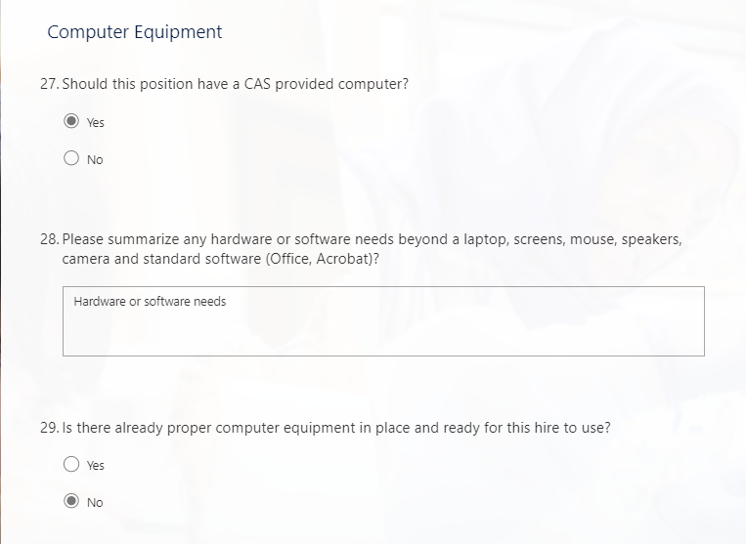
Computer Equipment
27. Select Yes or No. 28. Enter the hardware and software needs. 29. Select Yes or No
If you select yes, please enter the name of the employee who was last assigned the computer. This will present itself as an additional question below.

Slide 29
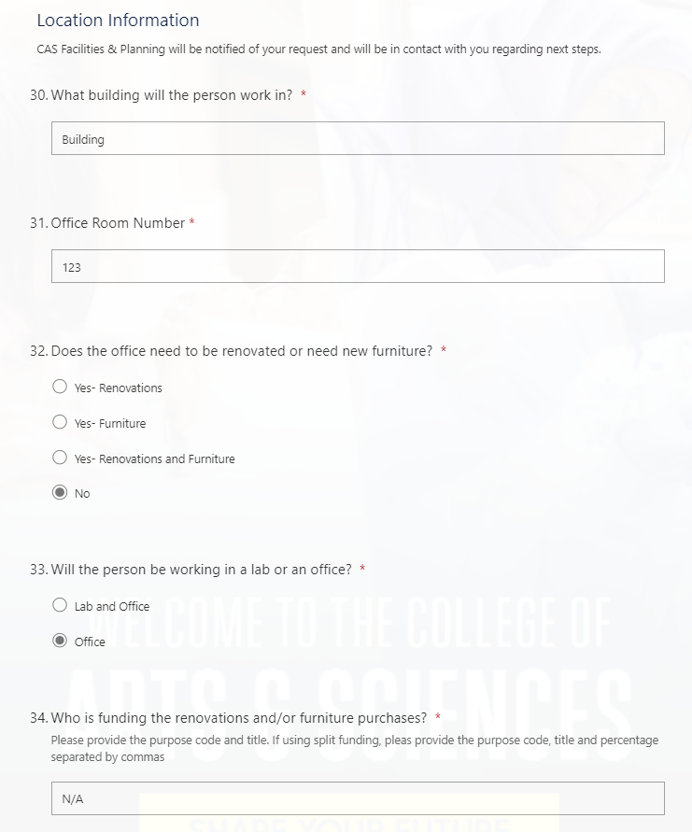
Location Information
30. Enter the building that the person will be working in. 31. Enter the office room number. 32. Select Yes or No. 33. Select Lab and Office OR Office
If selecting Lab and Office, lab location and renovation questions will appear below. 34. Enter the purpose code. If using split funding, please provide the purpose code, title and percentage separated by commas

Slide 30
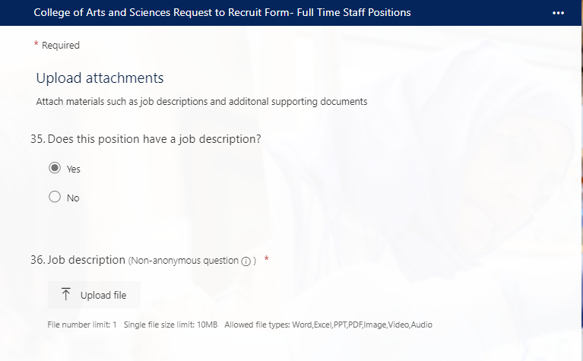
Upload Attachments
35. Select Yes or No. 36. If Yes, Upload the job description.

Slide 31
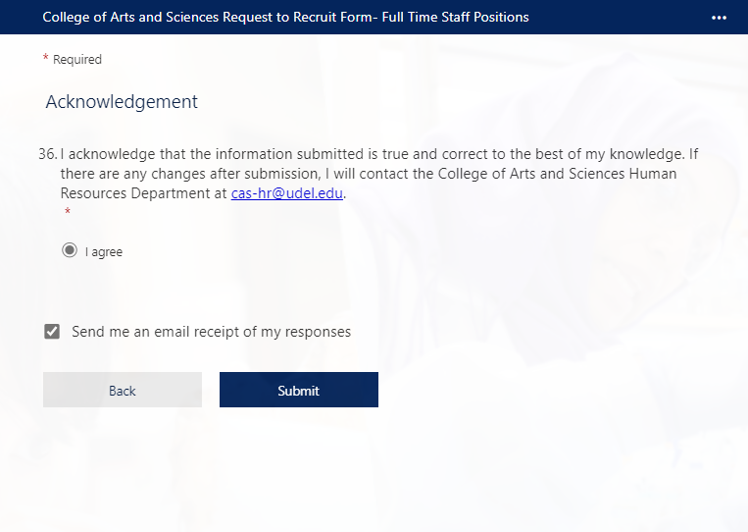
Acknowledgement
36. Select I agree If you would like a receipt of your email responses, please select the check box Click Submit

Slide 32
Requesting a Waived Search with an Existing Position Number

Slide 33
Requestor Information
Please enter the requestor’s name
Enter the email address.
If you are entering this information for another staff or faculty member, please enter their information.

Slide 34
New or Existing Position
3. Enter the number of positions you are requesting to fill.
Please note that if you need to fill multiple positions that are a combination of new and existing positions with different titles, funding sources, etc. or if you are filling more than one waived search, you will need to submit multiple forms.
4. Select Yes to replace an existing position.

Slide 35
Existing Position Information 5. If you know the position number, please select Yes. If not, please select No. If you select No, you will you will be prompted to enter the name of the employee you will be replacing and their position title. These will present themselves as additional questions. 6. If you selected yes for the above question, will be required to enter the position number. If you are filling multiple positions, please separate numbers by a comma. 7. Enter the first and last name of the employee(s) being replaced. If you are replacing multiple employees, please separate names by a comma. 8. Enter the position title. If you need to fill multiple positions with different titles you will need to submit multiple forms.

Slide 36
Is this a Waived Search?
9. Select Yes

Slide 37
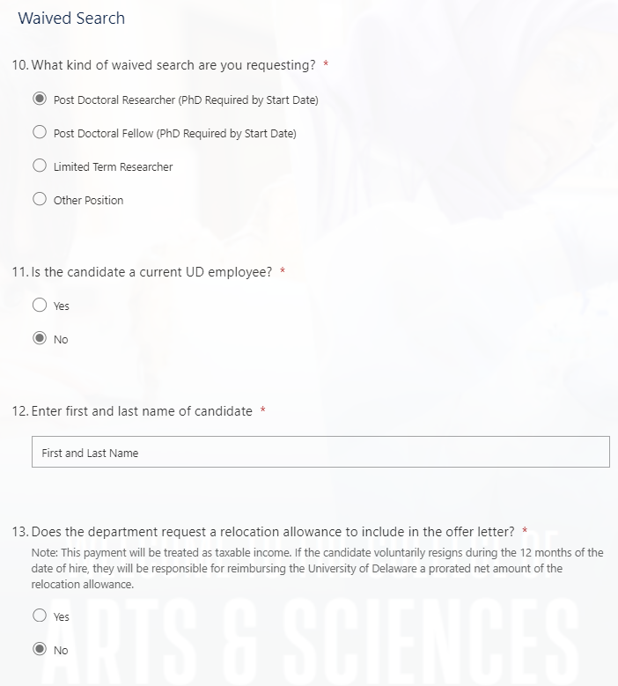
Waived Search Information for an External Candidate
10. Type of waived search.
If you select other, please enter the position title. This option will present as an additional question.
11. Select No.
12. Enter first and last name.
13. Select Yes or No.
If you select Yes, you will be prompted to enter a relocation allowance that will present as an additional question.

Slide 38
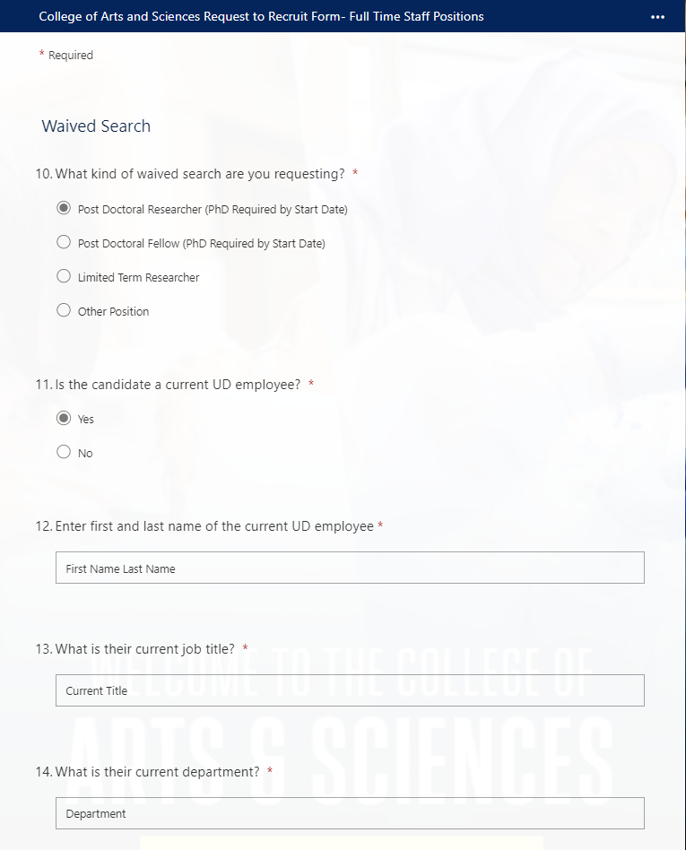
Waived Search Information for a Current UD Employee
10. Type of waived search.
If you select other, please enter the position title. This option will present itself as an additional question.
11. Select Yes.
12. Enter first and last name.
13. Enter current job title.
14. Enter current department.

Slide 39
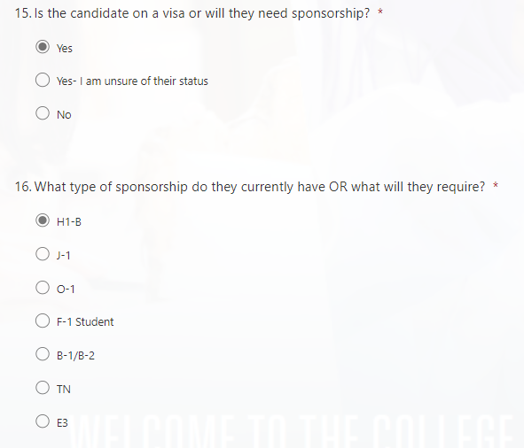
Waived Search Information for a Candidate or Current Employee who needs Sponsorship
15. Select Yes or Yes- I am unsure of their status
If you select ‘I am unsure of their status’, the visa options will not appear and HR will verify.
16. If you selected Yes, select type of sponsorship.

Slide 40
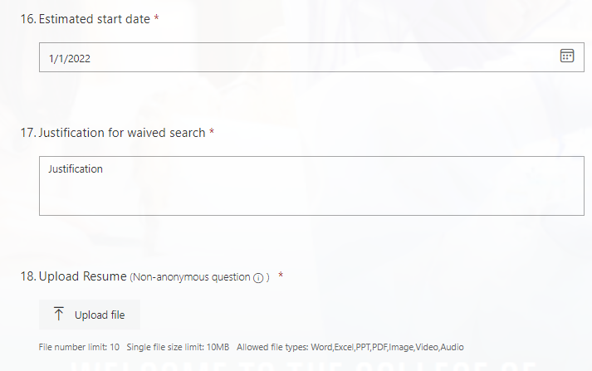
Waived Search Information Continued
16. Use the calendar to select an estimated start date.
17. Provide justification for waived search.
18. Upload resume.

Slide 41
General Position Questions
19. Select the Portfolio/Unit that the position falls under.

Slide 42
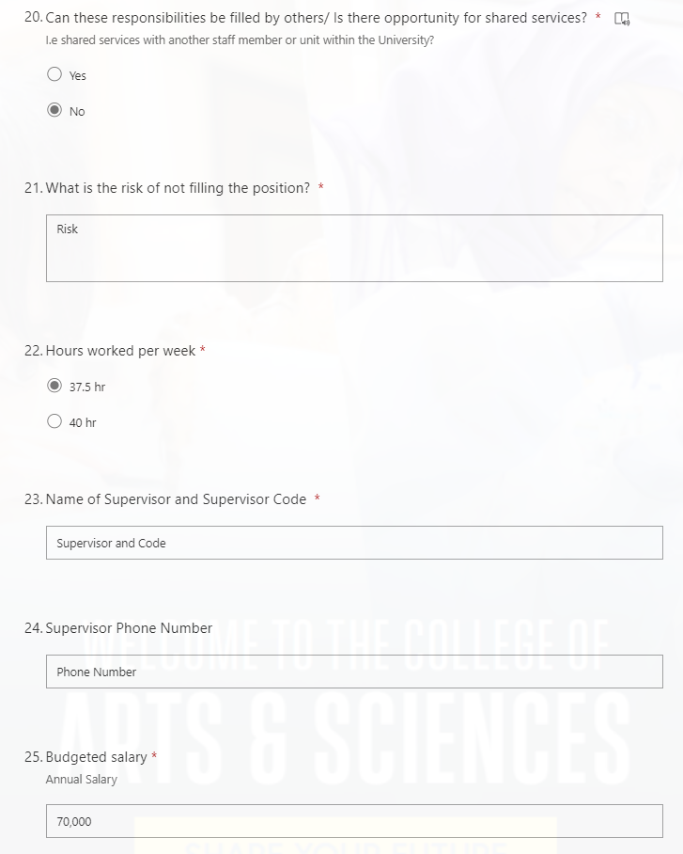
General Position Questions Continued
20. Select Yes or No.
If you select Yes, you will need to provide an explanation below. This option will reveal itself as an additional question. 21. Enter your answer for the risk of not filling the position. 22. Select the hours worked per week. 23. Enter the name of the Supervisor and Supervisor Code. 24. Enter the Supervisor Phone Number. 25. Enter the Budgeted Salary.

Slide 43
General Position Questions Continued
26. Select the Work Schedule. If you select Other, you will need to provide the work schedule. This option will reveal itself as an additional question. 27. Select Yes or No 28. Select 100% or Less than 100% If you select less than 100% , please provide the percentage of the job that can be performed remotely and the hybrid work schedule. Selecting these options will reveal additional questions below. 29. Enter the Purpose Code and Title. If you are using split funding please provide the purpose codes, titles and percentages.

Slide 44
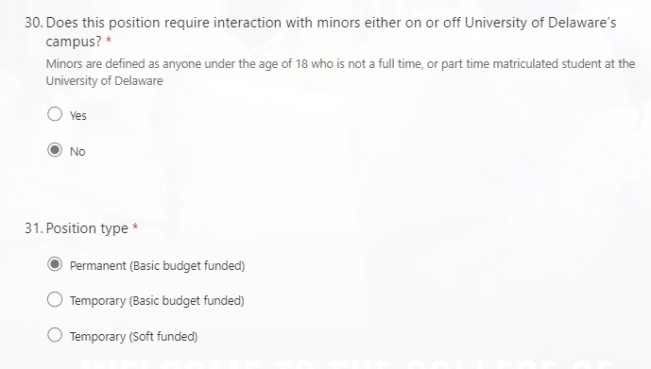
General Position Questions Continued
30. Select Yes or No.
31. Select the Position Type.
If you select a temporary position, the years of funding duration options will be revealed as an additional question below.

Slide 45
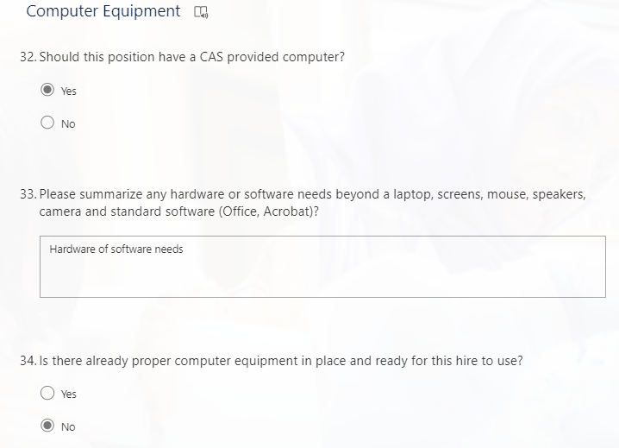
Computer Equipment
32. Select Yes or No. 33. Enter the hardware and software needs. 34. Select Yes or No.
If you select yes, please enter the name of the employee who was last assigned the computer. This will present itself as an additional question below.

Slide 46
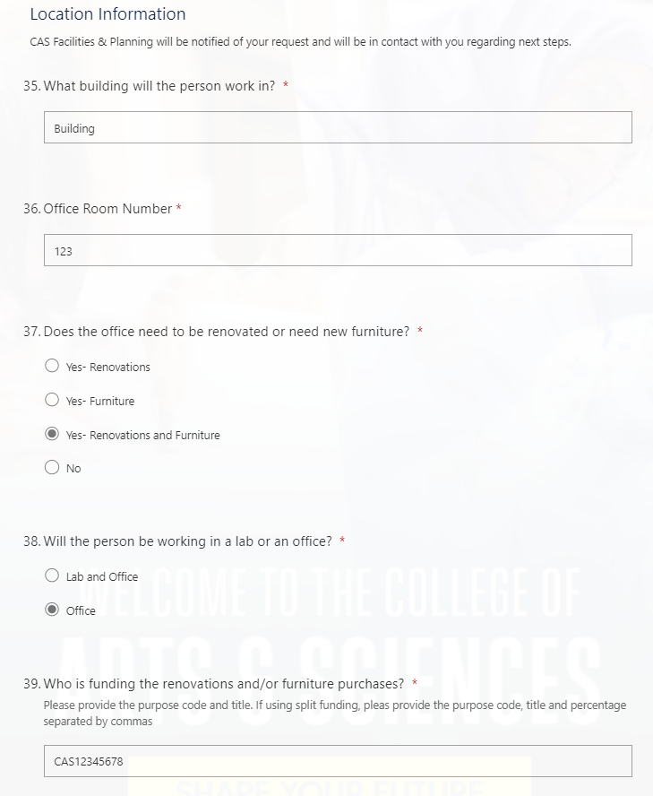
Location Information
35. Enter the building that the person will be working in. 36. Enter the office room number. 37. Select Yes or No. 38. Select Lab & Office OR Office
If selecting Lab and Office, lab location and renovation questions will appear below. 39. Enter the purpose code. If using split funding, please provide the purpose code, title and percentage separated by commas

Slide 47
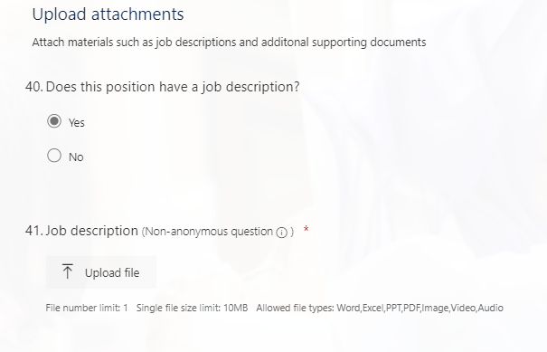
Upload Attachments
40. Select Yes or No. 41. If Yes, Upload the job description.

Slide 48
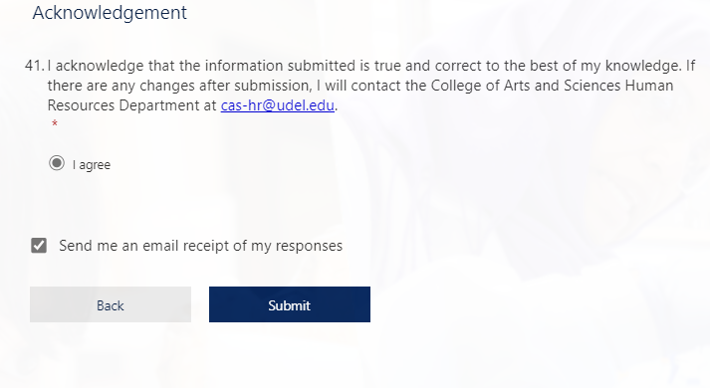
Acknowledgement
41. Select I agree . If you would like an emailed receipt of your responses, please select the check box. Click Submit.

Slide 49
Requesting a Waived Search with a New Position Number

Slide 50
Requestor Information
Please enter the requestor’s name
Enter the email address.
If you are entering this information for another staff or faculty member, please enter their information.

Slide 51
New or Existing Position
3. Enter the number of positions you are requesting to fill.
Please note that if you need to fill multiple positions that are a combination of new and existing positions with different titles, funding sources, etc. or if you are filling more than one waived search, you will need to submit multiple forms.
4. Select No to replace an existing position.

Slide 52
New Position Information
5. Enter the justification for the new position.
6. Provide context of the job.
7. Create an advertisement summary
This should be a quick description to entice the applicant to explore the job.
8. State Major Responsibilities.
9. Enter the Qualifications.

Slide 53
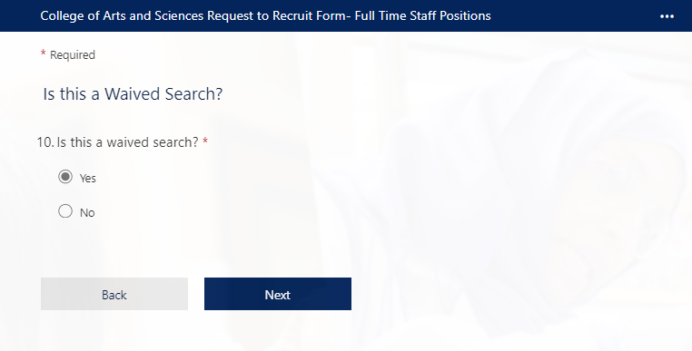
Is this a Waived Search?
10. Select Yes.

Slide 54
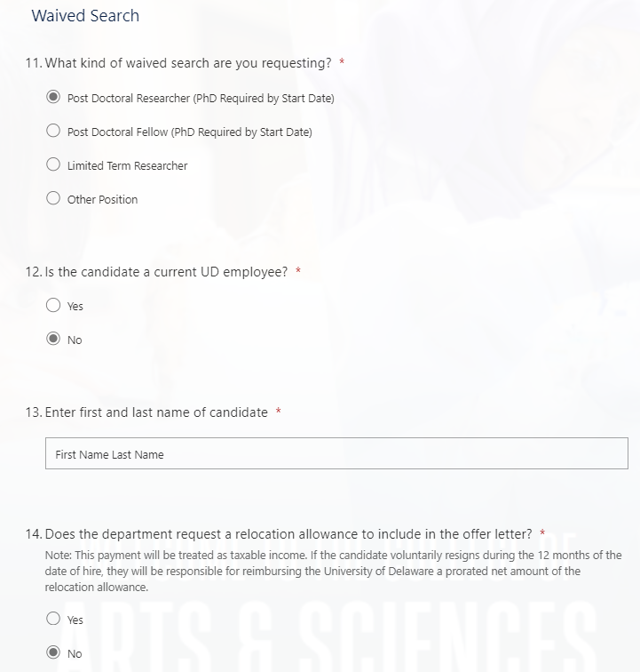
Waived Search Information for an External Candidate
11. Type of waived search.
If you select other, please enter the position title. This option will present as an additional question.
12. Select No.
13. Enter first and last name.
14. Select Yes or No.
If you select Yes, you will be prompted to enter a relocation allowance that will present as an additional question.

Slide 55
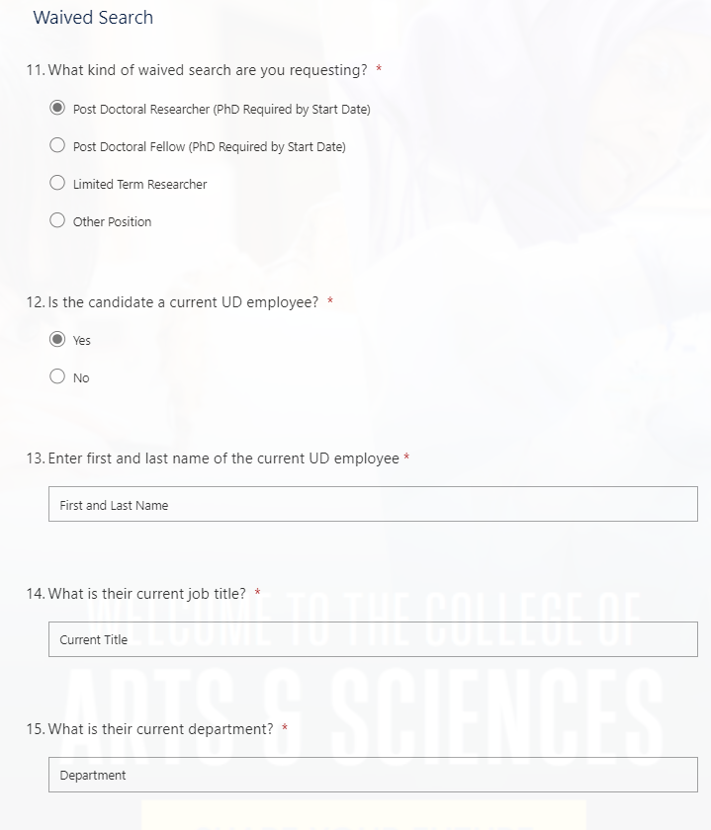
Waived Search Information for a Current UD Employee
11. Type of waived search.
If you select other, please enter the position title. This option will present itself as an additional question.
12. Select Yes.
13. Enter first and last name.
14. Enter current job title.
15. Enter current department .

Slide 56
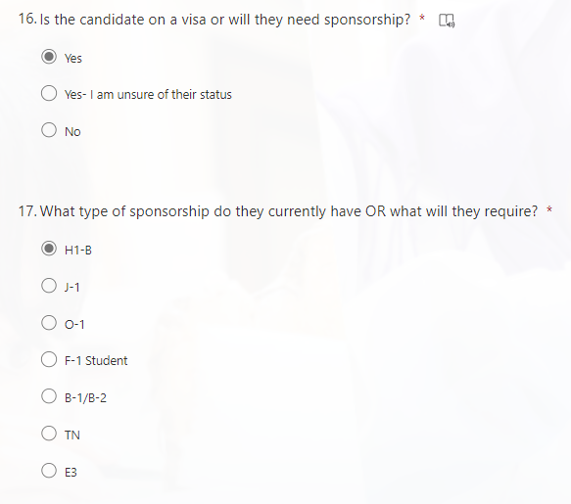
Waived Search Information for a Candidate or Current Employee who needs Sponsorship
16. Select Yes or Yes- I am unsure of their status
If you select ‘I am unsure of their status’, the visa options will not appear, and HR will verify.
17. If you selected Yes, select type of sponsorship.

Slide 57
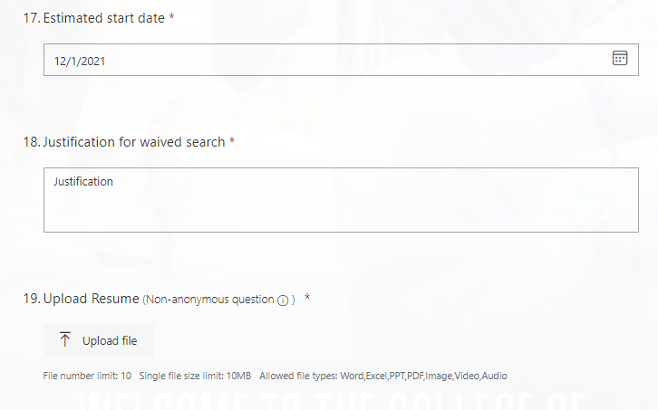
Waived Search Information Continued
17. Use the calendar to select an estimated start date.
18. Provide justification for waived search.
19. Upload resume.

Slide 58
General Position Questions
20. Select the Portfolio/Unit that the position falls under.

Slide 59
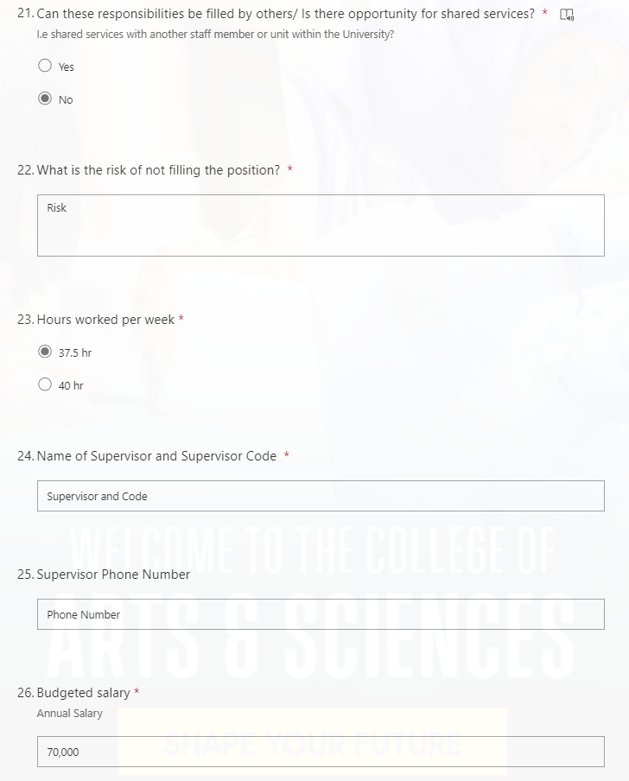
General Position Questions Continued
21. Select Yes or No.
If you select Yes, you will need to provide an explanation below. This option will reveal itself as an additional question. 22. Enter your answer for the risk of not filling the position. 23. Select the hours worked per week. 24. Enter the name of the Supervisor and Supervisor Code. 25. Enter the Supervisor Phone Number. 26. Enter the Budgeted Salary.

Slide 60
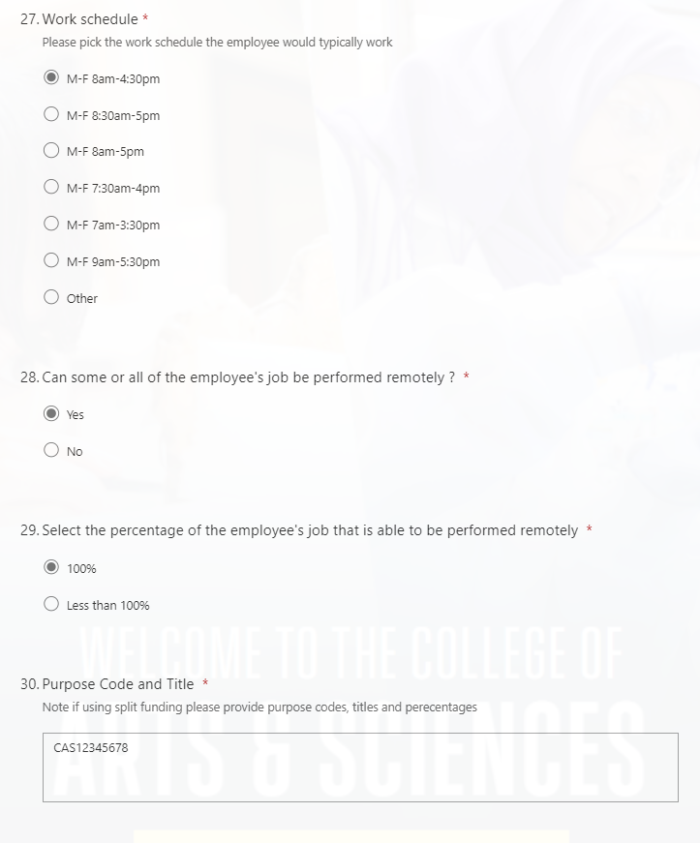
General Position Questions Continued
27. Select the Work Schedule. If you select Other, you will need to provide the work schedule. This option will reveal itself as an additional question. 28. Select Yes or No. 29. Select 100% or Less than 100%. If you select less than 100% , please provide the percentage of the job that can be performed remotely and the hybrid work schedule. Selecting these options will reveal additional questions below. 30. Enter the Purpose Code and Title. If you are using split funding please provide the purpose codes, titles and percentages.

Slide 61
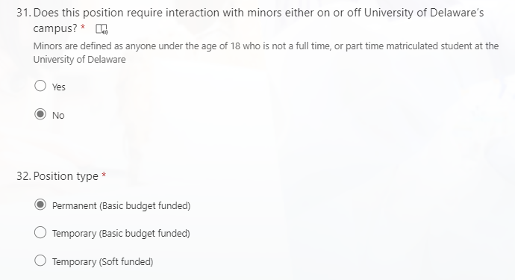
General Position Questions Continued
31. Select Yes or No.
32. Select the Position Type
If you select a temporary position, years of funding duration options will be revealed as an additional question below.

Slide 62
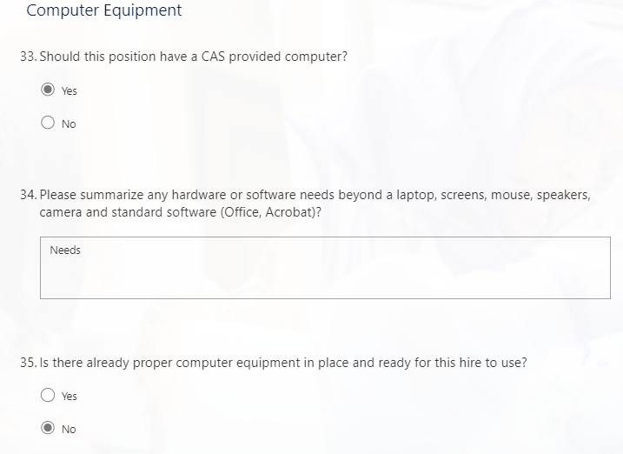
Computer Equipment
33. Select Yes or No. 34. Enter the hardware and software needs. 35. Select Yes or No
If you select yes, please enter the name of the employee who was last assigned the computer. This will present itself as an additional question below.

Slide 63
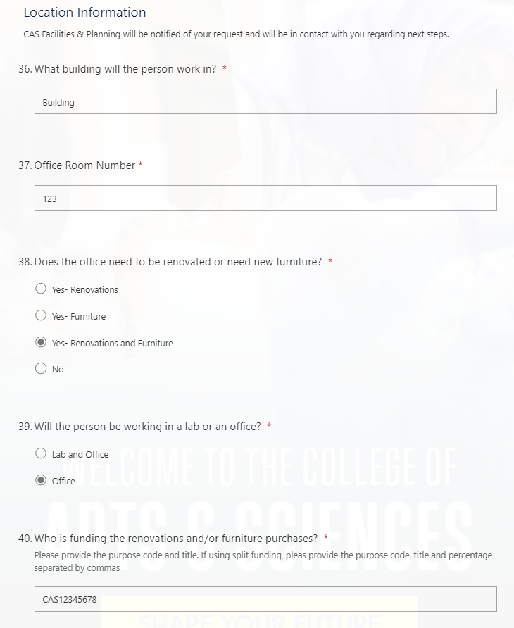
Location Information
36. Enter the building that the person will be working in. 37. Enter the office room number. 38. Select Yes or No. 39. Select Lab & Office OR Office.
If selecting Lab and Office, lab location and renovation questions will appear below. 40. Enter the purpose code. If using split funding, please provide the purpose code, title and percentage separated by commas

Slide 64
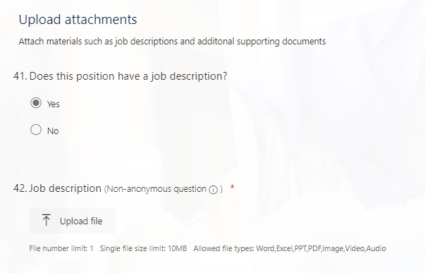
Upload Attachments
41. Select Yes or No. 42. If Yes, upload the job description.

Slide 65
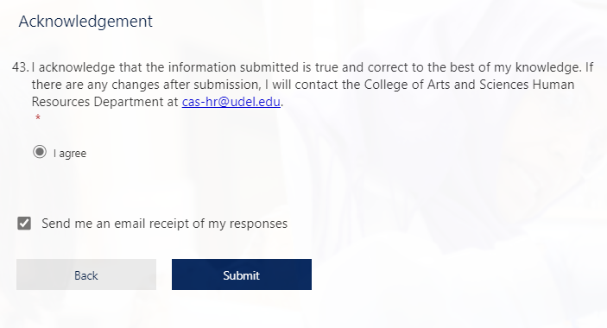
Acknowledgement
43. Select I agree. If you would like an emailed receipt of your responses, please select the check box. Click Submit.

